Slide 1
A Tale of Two Lakes
Lakes of Gowdanapalya – Dorekere & Gowdanakere
By Prarthana School, Padmanabhanagar, Bangalore
Participants:
Anikethan S. J. | Varsha Nagesh | Prajwal A. R. | Vaishnavi S. | Bapu Pruthvidhar
Vishwajeeth P. | Jyothsna P. V. | Shreyas S. S. | Koustubha C. | Prithvi G. Koundinya

Slide 2
Introduction
Water is priceless.
Lakes and rivers are sources of fresh water to people, plants and animals.
These lakes seem to be vanishing due to urbanization.
Two such diseased lakes considered for study – Dorekere and Gowdanakere.

Slide 3
Objectives
To analyze the impact of urbanization on the quality of the two lakes considered for study and also the impact of the interconnection between the two on the same.
Propose measures to conserve, protect, restore and sustainable management of the lakes
Creating awareness about the lake environment among the people surrounding.

Slide 4
Study Area-Gowdanapalya
Gowdanapalya - a residential locality in Bangalore, India.
Two major sources of water a few years ago
Dorekere
Gowdanakere
Gowdanakere is heading towards extinction due to people’s lack of care and concern.

Slide 5
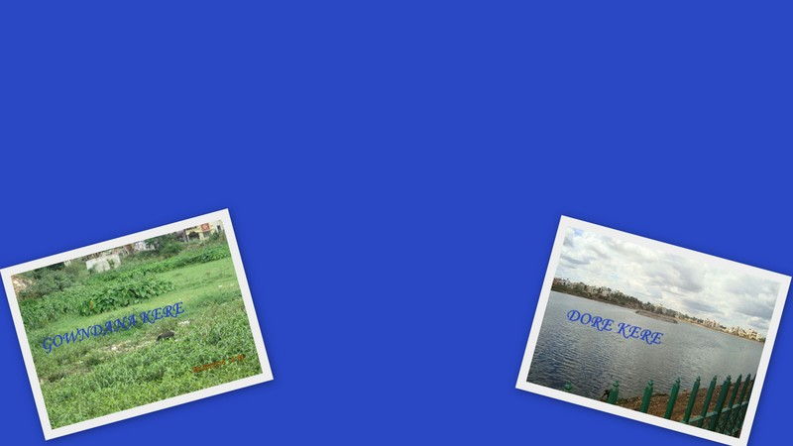
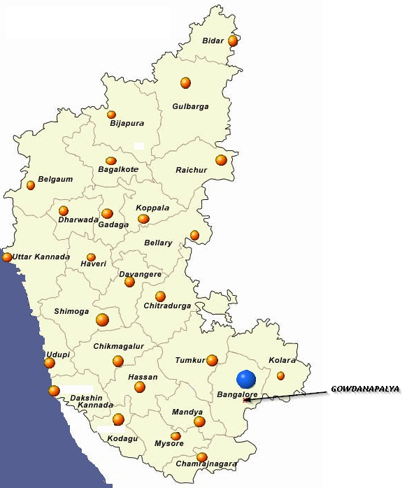
Gowdanpalya

Slide 6
Lake Facts
Parameter | Gowdanakere | Dorekere
Original Area | 9 Acres | 28.5 Acres
Present area | 3.89 Acres | 22.1 Acres
Encroachment | 5.11 Acres | 6.4 Acres approx.
Past glory:
The two lakes once upon a time formed a mesmerizing landscape.
The water fed the cattle around, housed schools of fish and also a varied species of birds.
They aided water cycle and also kept the ground water table rich.
Reason for degradation:
Improper waste management.

Slide 7
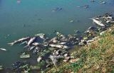
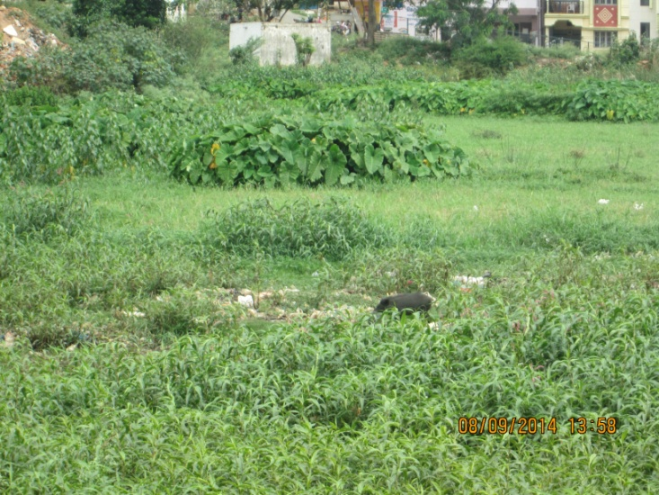
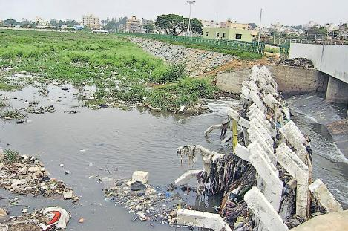
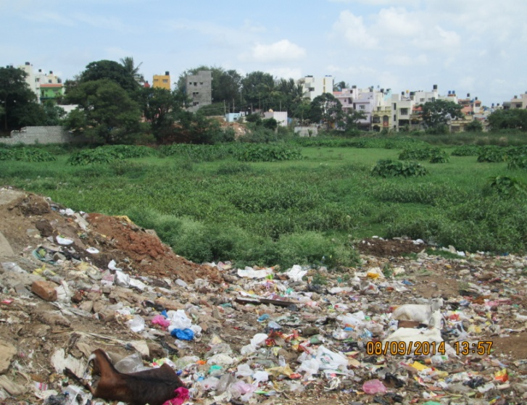
Dorekere and Gowdanakere -In their polluted forms

Slide 8
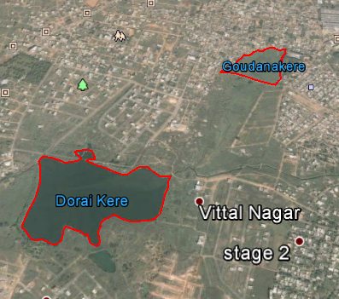
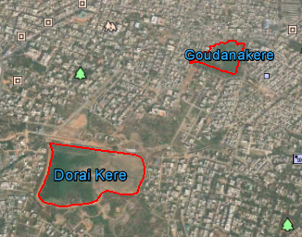
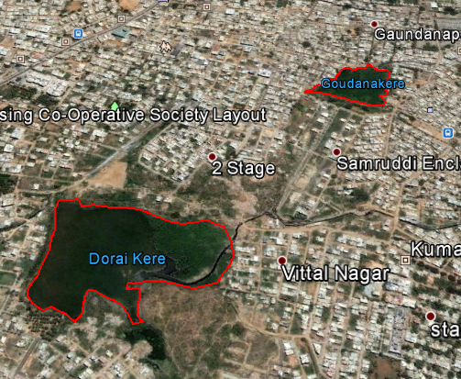
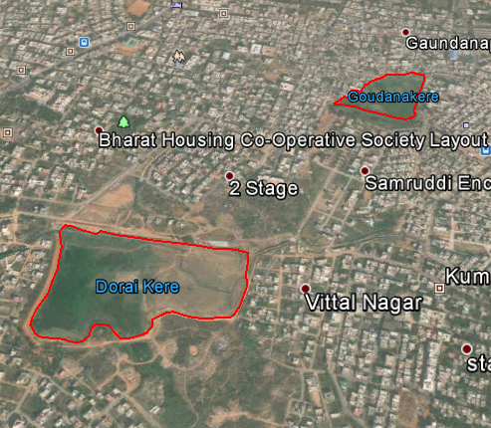
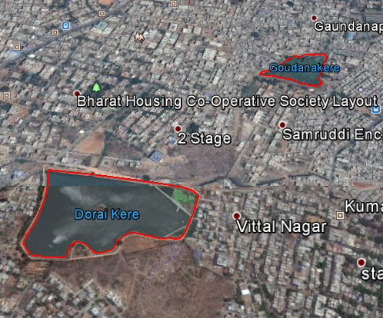
Mapping
Year 2000
Year 2005
Year 2008
Year 2005
Year 2010
Year 2014

Slide 9
Approximate Area and Perimeter of the two lakes (as obtained upon mapping)
 | Gowdanakere |  | Dorekere
Year | Area in Acres | Perimeter in km | Area in Acres | Perimeter in km
2000 | 5.71 | 0.7 | 25.2 | 1.72
2005 | 5.33 | 0.7 | 24.7 | 1.7
2008 | 5.21 | 0.7 | 23.3 | 1.59
2010 | 4.78 | 0.7 | 22.1 | 1.34
2014 | 3.89 | 0.61 | 22.1 | 1.34

Slide 10
Case Study
Visits to Gowdanakere and Dorekere, under different weather conditions.
Observation of the present condition of the two lakes.
Observation of flora and fauna around the lakes.
Interactions with the people residing around the lakes.

Slide 11
Observations at Dorekere
Rising water table
Flourishing aquatic life.
Clean surroundings
A beautiful relaxing spot for the people.
Significant improvement in water quality after the establishment of water treatment plant
Reborn as a host to aquatic life and migratory birds.

Slide 12
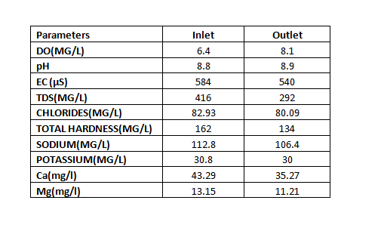
Water Analysis Report

Slide 13
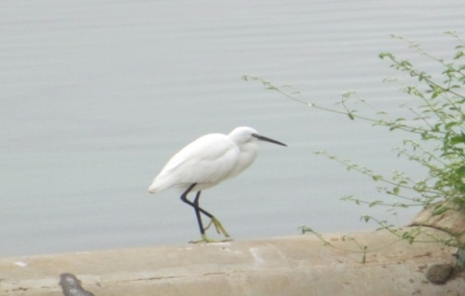
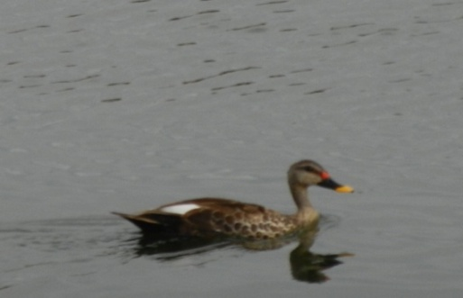
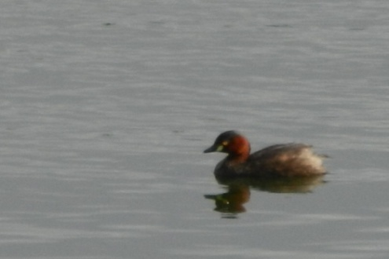
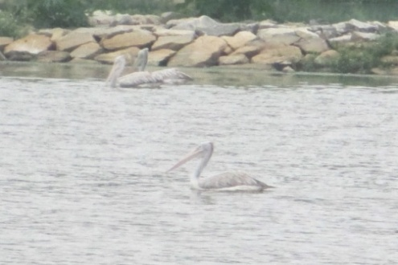
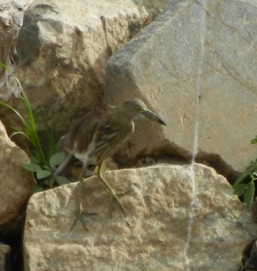
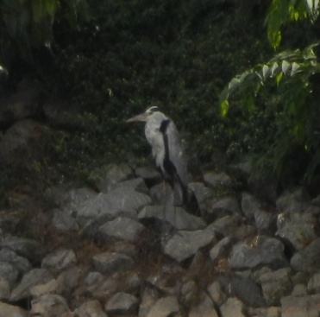
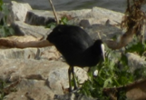
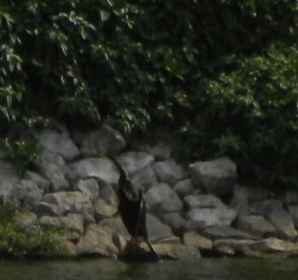
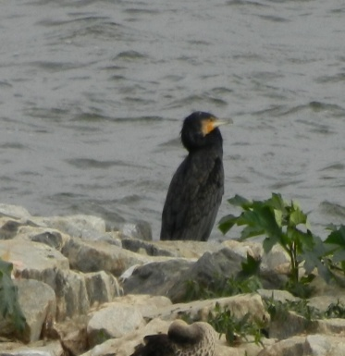
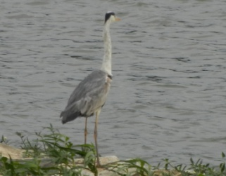
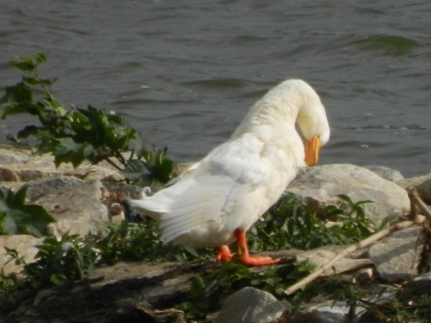
Birds at Dorekere
Spot billed Pelican
Spot billed Duck
Little Grebe
Little Egret
Pond Heron
Night Heron
Common Coot
Darter
Large Cormorant
Grey Heron
Domestic Goose

Slide 14
Observations at Gowdanakere
Water : no water except some sewage remnants
The slums around it have encroached the lake by more that 2/3rd of its actual area
Biological parameters: Various emergent plants like collacasia, ludwigia, typha, cypherus etc have come up.
The people around have almost become insensitive to the obvious stink from the lake.

Slide 15
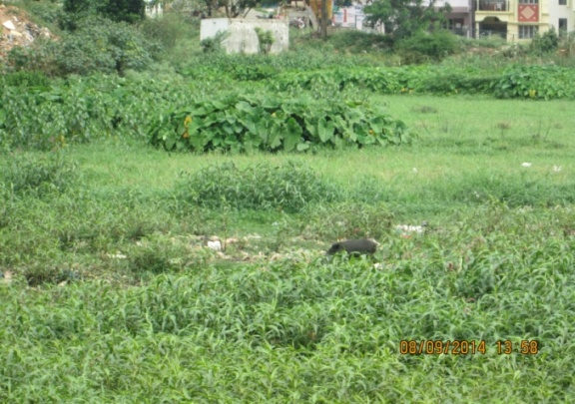
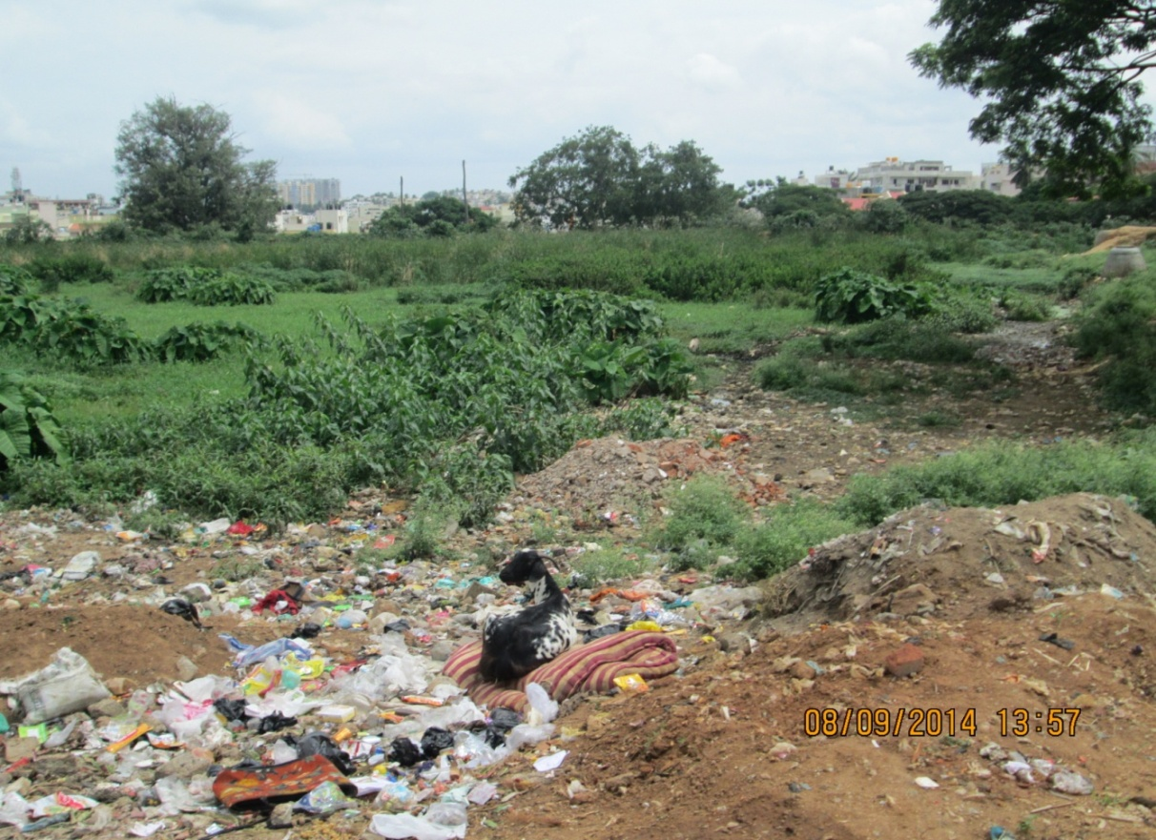
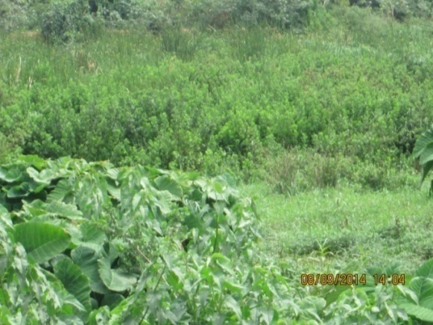
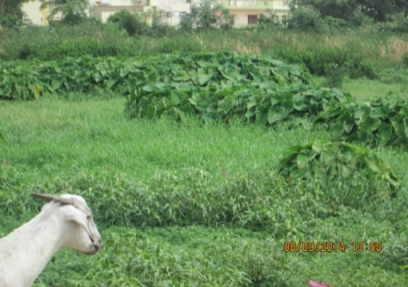
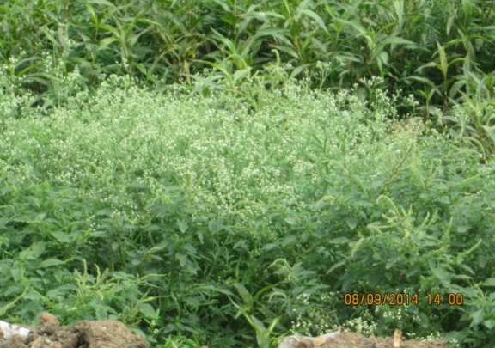
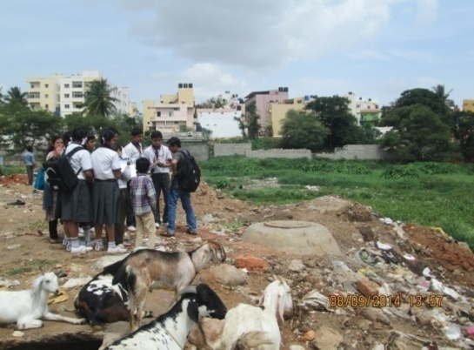

Slide 16
The Actual Disaster
The two lakes are interconnected, with sewage water flowing from Gowdanakere to Dorekere.
The STP set up at Dorekere can treat upto 1MLD of sewage water.
Restriction of the inflow of sewage water into Dorekere to 1 MLD by regulating at Gowdanakere.
This resulted in overflowing of contaminated water at Gowdanakere.

Slide 17
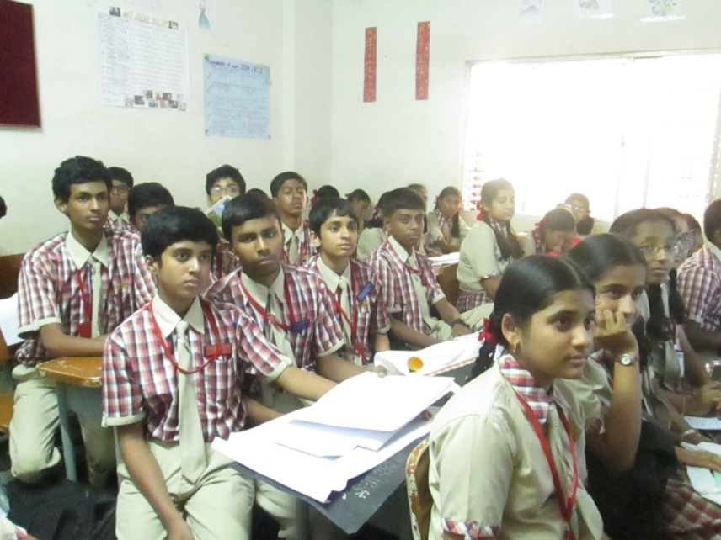
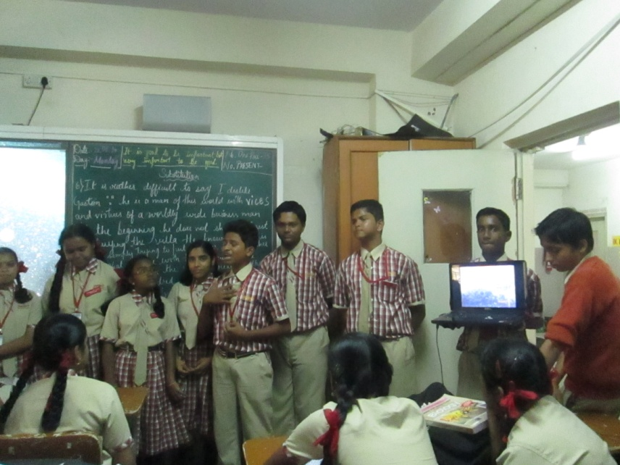
Measures Taken
Spreading awareness at school.
We personally visited the high school sections and gave a short presentation.

Slide 18
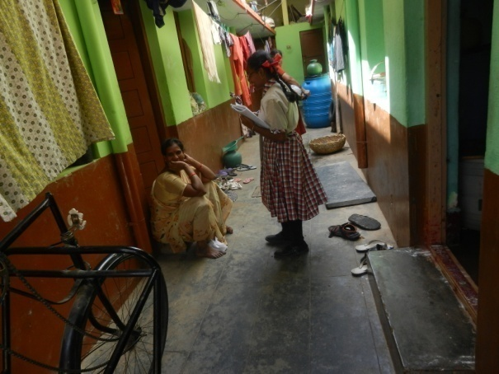
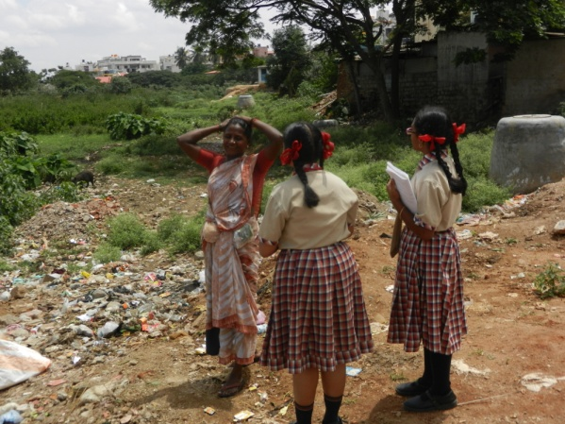
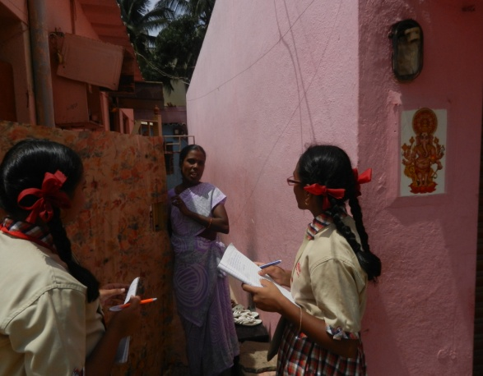
Measures Taken
Educating the people around the lake.
We personally went to the houses of the people who lived around the lake , spoke to them about the problems they faced and also educated them about the need for lakes and their responsibilities towards it.

Slide 19
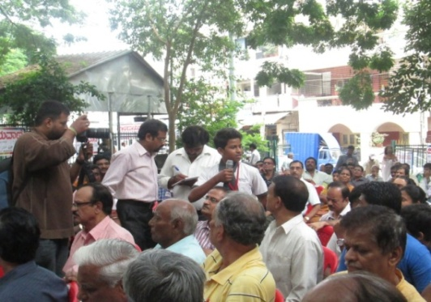
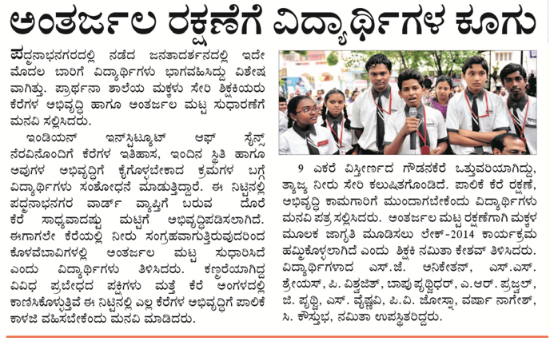
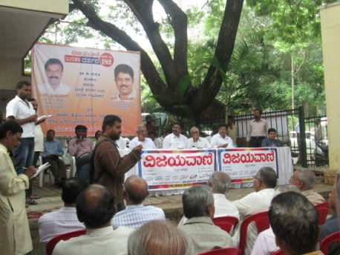
Measures Taken
Proposing possible solutions to the concerned officials.
We participated in the Janata Darshana, a program where the corporator of the area directly interacts with the residents concerning their problems, presented a comparative study of the two lakes and suggested that works similar to what was done at Dorekere be replicated at Gowdananakere too. The event was published in the daily newspaper -‘Vijayavani’.

Slide 20
Conclusion
This study is a perfect example of what disasters some unmonitored and unethical human activities could cause to some of the most precious jewels gifted to us, for our own good, by nature.
The call of the hour is that unless nursed immediately, the very lakes that have supported our sustenance will disappear leaving us with nothing to bank upon.
We are not inheriting the Earth from our ancestors, but borrowing it from our children!!
– An Ancient Proverb

Slide 21

Questions

Slide 22
Thank you!

